Slide 1
Salesforce Practitioners

Slide 2

Sonali Sahu, Sr. Developer(Salesforce)
Sonali.sahu@brillio.com
Toronto, Canada
Industry Experience: Healthcare, Software Cloud Computing, Petroleum
Professional Summary
6.5 years of experience in IT industry playing the role of a Salesforce Developer
Proficient in Salesforce Development, Apex (Synchronous and Asynchronous), Admin, Lightning Web Components, Salesforce integrations, Flows, Debugging and some of other Admin tools.
• Experienced with Copado and Flosum for continuous Integration, deployment and release management.
Relevant Project Experience
Client: Leaf Home, Role: Sr. Salesforce Developer
• Developed custom solutions and extensions for Salesforce field Service Lightning (FSL) platform using Apex, Visualforce, Lightning Components, Flows, and JavaScript to meet specific business requirements and enhance field service operations.
Understanding of Salesforce security best practices, including role hierarchy, profiles, permission sets, and Apex sharing and sharing settings to ensure data privacy and compliance with regulatory requirements.
Configured and customized FSL objects, including Work Orders, Skill and Work type, Service Appointments, Assets, and Service contracts and Service Territories, Operating Hours, Service resources, Contract Line Items and Entitlements, Cases and Scheduling policy to meet client requirements.
Designed and implemented custom solutions using Field Service Lightning to streamline work order management, asset tracking, territory, Field service mobile App and Field service scheduling and optimization by Dispatcher Console with Gantt chart and Scheduling Optimizer.
Collaborated with cross-functional teams, including business analysts, architects, and administrators, to gather requirements, design solutions, and ensure successful delivery on time.
Worked closely with stakeholders and end-users to gather feedback, iterate on solutions, and drive continuous improvement and innovation in FSL implementations.
Worked on Salesforce enhancements and bringing existing code into best practices including security, scalability, and Salesforce limits.
Did requirement and code analysis to complete enhancements required in client system efficiently.
Client: Zendesk, Role: Sr. Salesforce Developer
Created approval processes for quotes, contracts, and discounts including approval criteria, approval steps, escalation rules, and notification workflows to ensure compliance, governance, and accuracy in quote approvals.
Designed and implemented subscription management processes, including billing schedules, renewal automation.
Analyzed existing code and find the optimal solutions for the requirement mentioned in helpdesk tickets.
Did admin/dev work as and when need to achieve the requirement.
Core Skill Sets
Proficient in developing LWC, Aura, Apex, Flows, and other Salesforce standard features.
Requirement Gathering, Solution Design and Implementation.
Experienced in working across various SFDC implementations covering Sales, Service, CPQ, Field Service Lightning and Conga(Apttus) CPQ.
Certifications
Salesforce Certified Administrator
Salesforce Certified App Builder
Salesforce Certified Platform Developer I
Salesforce Certified Heroku Architecture Designer
Recent Roles
Salesforce Sr. Developer
Salesforce Developer
Key Clients
Leaf Home
BOX
GE Healthcare
British Petroleum
Confluent
Zendesk

Slide 3
Sonali Sahu, Sr. Developer(Salesforce)
Client: Box, Role: Salesforce Developer
Performed analysis and coordinated with other developers to design and code systems.
Analyzed code and corrected errors to optimize output.
Integrated Conga(Apttus) CPQ with subscription billing platforms such as Zuora to enable seamless end-to-end subscription management.
Designed and developed Lightning Components and LWC for custom user interfaces and enhanced user experience within the Salesforce platform.
Set-up Email-To-Case, Web-to-Case, Case Management, Knowledge Management, Case Support Process/Settings, Reports and Dashboard.
Case Assignment Rules, Escalation Rules, Approval Rules, Auto Response Rules,.
Configuration of email to case setup, creation of fields, process builder, custom labels, custom metadata, LWC (Lightning web components). Different APIs payloads for connecting with salesforce from Mulesoft.
Developed Apex classes to interact with components and attain functionality.
Built Platform Events and Implemented Salesforce File Connect to integrate with SharePoint.
Working knowledge on Remote site setting.
Involved in fixing production code bugs and assisting end users for production issues.
Prioritized work effectively and handled multiple competing demands.
integrated Salesforce with third-party applications via REST/SOAP.
Product and service configuration with constraint rules, attribute rules.
Created bundle products, price list and pricelist line-items then migrated using X-Author Data Migration tool, Data loader.
Identified and developed process improvements that facilitated knowledge transfer to others.
We have developed several customized functionalities on top of Conga(Apttus) CPQ functionality to fulfill the client's requirements
X-author conga template creation and modification.
Client: Confluent, Role: Salesforce Developer
Product and service configuration with Price rules, Order forms, Quote templates, Approval Rules, Product rules, Attributes, Contract, Bundle Configuration, Lookup Queries, Discount Schedule, Option Constraints, CPQ Quote Document Generation, QCP Scripts, QLE experience, Subscriptions, Amendments and Renewals.
According to business requirements, created products, priced them, and validated them on the cart page.
Project Management with Team Leading, Problem Solving, Conflict Resolution, Teamwork and Collaboration, Adaptability, Critical
Conducted code reviews and implemented coding standards, ensuring high-quality and maintainable code.
Estimated work hours and tracked progress using scrum methodology.
Created fields, objects, validation rules, Workflow, Rules, Salesforce advanced approval process, Reports, Dashboards, Custom labels, Approval processes, Batch apex, lightning web components.

Slide 4
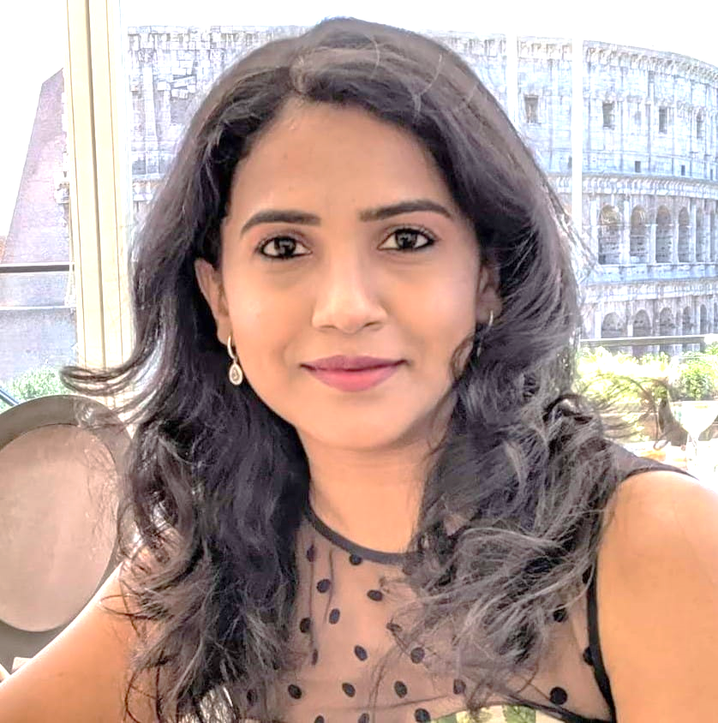
Alekhya Ravula, Senior Salesforce Developer
Professional Summary:
Salesforce Developer with 10 years of hands-on experience in Salesforce Development & Customization, Integration and Support, delivering tailored solutions aligning with business objectives.
Integration Expertise: Experienced in seamlessly integrating Salesforce with diverse systems, leveraging RESTful and SOAP APIs.
Technical Leadership: Lead teams in Salesforce initiatives, providing mentorship and driving best practices for successful implementations.
Problem Solving: Analyze complex requirements. Troubleshoot issues and optimize system performance for enhanced efficiency.
Proficient Apex, AURA Framework, Lightning Web Components.
Led end-to-end implementations, collaborating with cross-functional teams demonstrated functionality to stakeholders and actively participated in architecture discussions. .
Excellent communication and inter-personal skills, accustomed to working in both large and small
team environments.
Alekhya.ravula@brillio.com
San Jose, CA
Industry Experience:
Online Advertising, Payment Processing, Software Cloud Computing, Solar Industry, Cybersecurity, Internet Content & Information, Consumer Payment, Home Improvement & Safety
Core Skill Sets
Requirement Gathering, Solution Design and Implementation.
Proficient in developing LWC, Aura, Apex, Flows, and other Salesforce standard features.
Relevant Project Experience
TOAST, INC , SR. SALESFORCE DEVELOPER
Refactored code for Leads, Quotes, Campaigns to overcome the process time out errors caused by Process builders by moving it to Flows and APEX.
Provided solutions to move workflows, process builders and flows to apex and retire them.
Implemented batch classes to calculate the Assets based on Upsell, Downsell, Rebooked and Churned quotes.
Migrated integration users to Salesforce Integration license from Salesforce license to reduce the user license cost.
Worked on Salesforce CPQ functionality such as Opportunities, Product configurations, Product rules, Price rules, Quotes, Orders
and Contracts.
PINTEREST , SR. SALESFORCE DEVELOPER
Worked on End-to-End implementation of Headcount Employee Project where we read data from Workday every day and process Headcount and Team Member records accordingly using APEX and built Lightning components.
Certifications:
Salesforce Platform Developer 2
Salesforce Platform Developer 1
Salesforce Admin
Recent Roles
Sr. Salesforce Developer
Key Clients
Toast
Sunpower
Splunk
Pinterest
Adaptive Insights
Palo Alto networks

Slide 5
Alekhya Ravula, Senior Salesforce Developer
Worked on Team Member Check project where we display the Team Member records that have incorrect data on them so the users can get them corrected either in Workday or in SFDC based on the where it was wrongly entered or updated.
Worked on enhancement of existing LWC components.
Followed coding standards, best practices and participated in code reviews.
Written and performed unit tests and deployed code changes to various sandboxes accordingly.
SUNPOWER CORP , SR. SALESFORCE DEVELOPER
Developed Salesforce applications using Apex, Triggers, Visualforce, JavaScript, REST web services.
Built rich user experiences with custom Lightning components.
Implemented solutions in the Salesforce platform following best practices, including configuration, Apex, VF, Lightning.
Experience working within an Agile environment and used tools such as Pivotal Tracker, Jira etc.
Developed complex force.com applications using both declarative and customization capabilities.
Followed coding standards best practices and participated in code reviews.
Created and managed custom reports/dashboards, complex workflow rules, process builders.
Participated in business requirement and architecture discussions to understand and develop the features accordingly.
Managed and maintained salesforce sandbox usage planning, data migration and sandbox refreshes.
Written and performed unit tests and deployed code changes to various sandboxes accordingly.
Attention to detail and demonstrated capability in the execution of team projects.
ADAPTIVE INSIGHTS , SR. SALESFORCE DEVELOPER
Designed, developed and deployed the Custom objects, Page layouts, Custom tabs, Components, Visualforce Pages, Apex classes & Triggers to suit to the needs of the application.
Migrated data from old instance to new instance using Data Loader.
Worked on configuration and customization of Salesforce CPQ to fit in the business requirements.
Modified simple workflows to incorporate Email Alerts and Field Updates.
Worked with Formula fields for calculation, related object display and integration.
Worked with Organization Wide Defaults, Role Hierarchies, Sharing Rules and Manual sharing to implement Record-based sharing.
Used SOQL statements within the custom controllers, extensions and triggers properly to avoid Governor Limits.
Developed and configured various Reports for different user profiles based on the need in the organization.
Designed several types of Email templates for auto response to customers.
Keep application users informed about system functionality and enhancements.
Assisted in deployments, handled and fixed test class failures during validations.

Slide 6
Thank You Let’s create something amazing together

